Slide 1
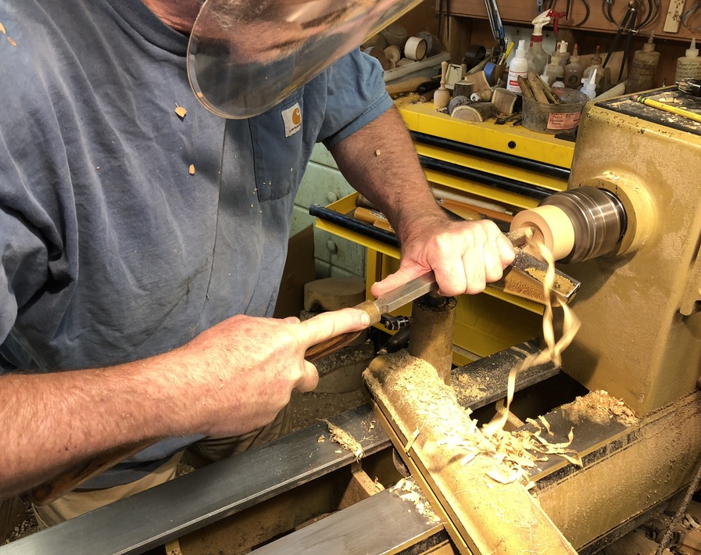
Northwest Woodturners Presentation: Why Turn?
How a Wood Lathe Holds onto its Work
Segment Prepared by Tom Willing

Slide 2
Mounting Material Onto The Lathe
Main Objective – to rotate work piece on the lathe axis.
Two primary elements – compression and friction:
Work piece captive between headstock and tailstock;
Augmented by spurs on drive centers
Screws on screw chucks and face plates
Chuck jaws can grip a spigot turned on the work piece itself.
Bonding a workpiece – under special circumstances
Double-stick tape, hot melt glue, assembled glue-ups;
Vulnerable to potentially catastrophic failure!

Slide 3
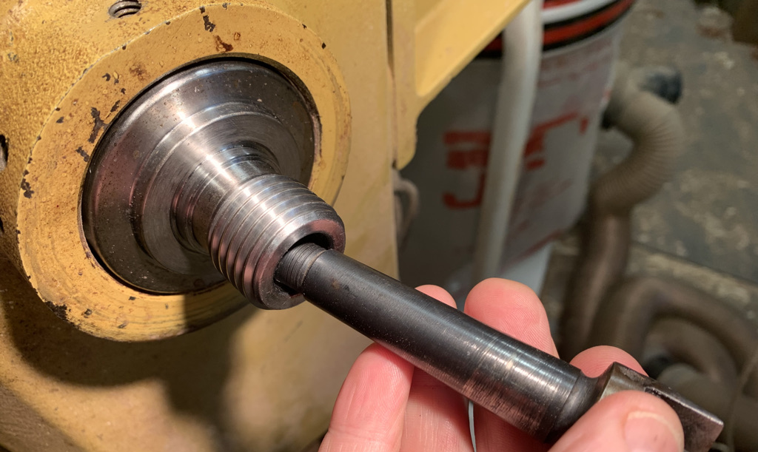
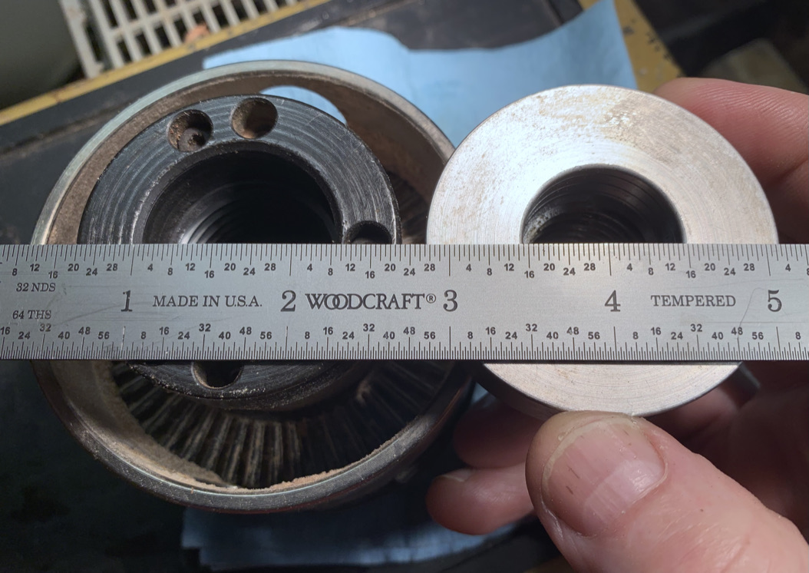
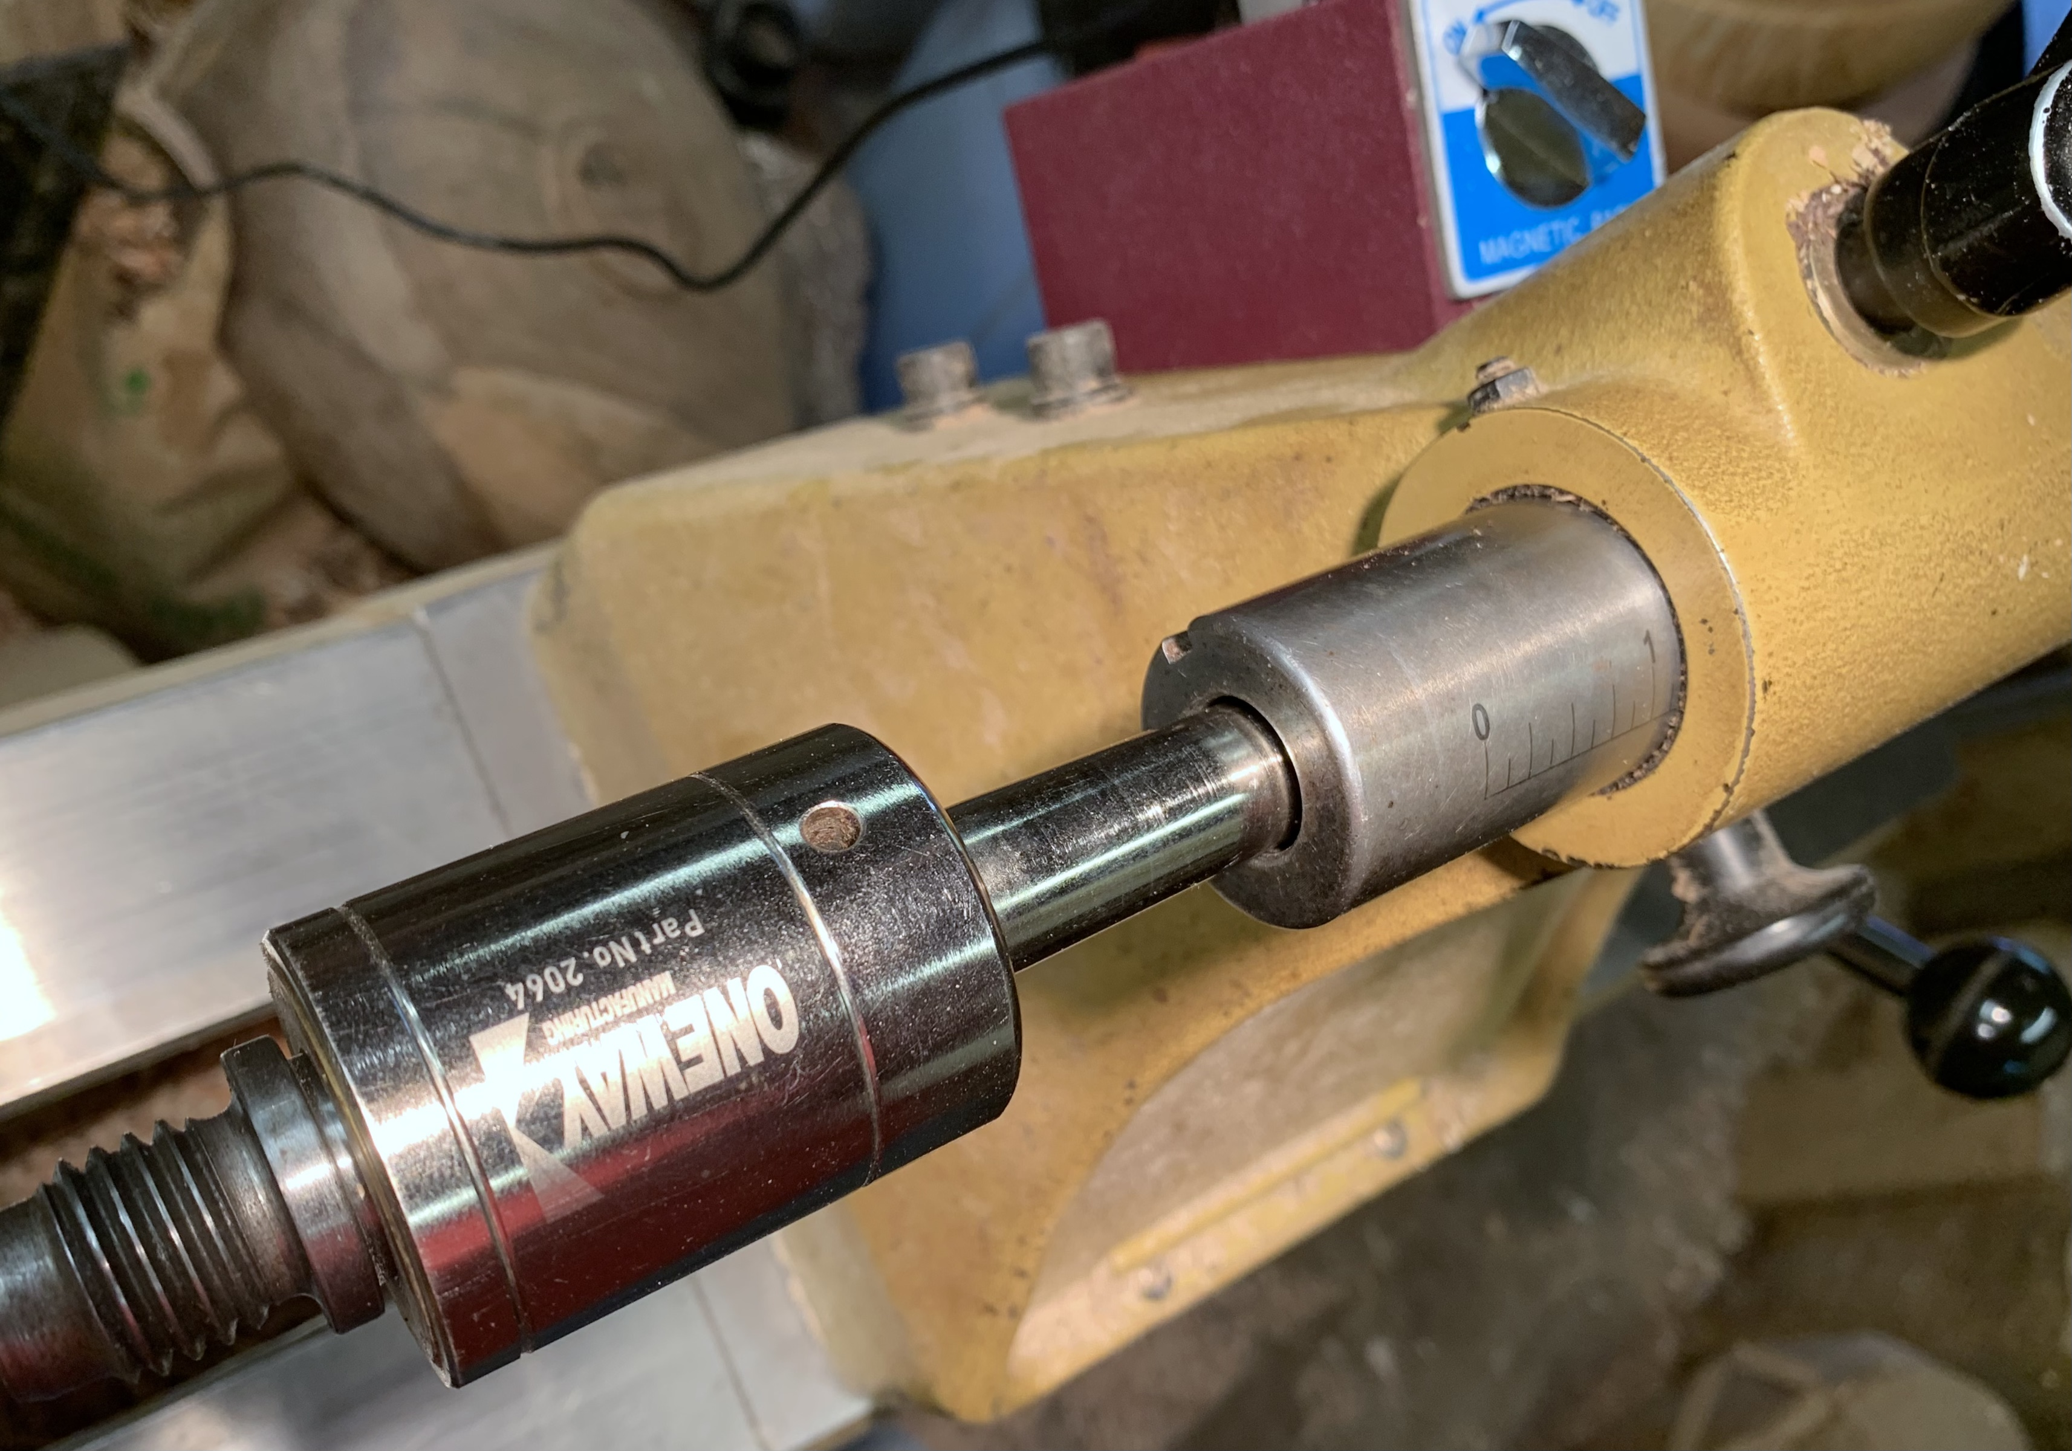
A Closer Look At Headstock and Tailstock:
Headstock – Drive Spindle
Male thread – 1”x 8tpi and 1¹/₄”x 8tpi are common;
Threaded adapters are available;
Morse taper inside.
Tailstock – Quill
Morse Taper inside
Locks in place
Handwheel advances quill into work piece
This adapter allows me to mount my chucks on different sized spindles.
Knockout bars are required to remove tapered accessories.

Slide 4
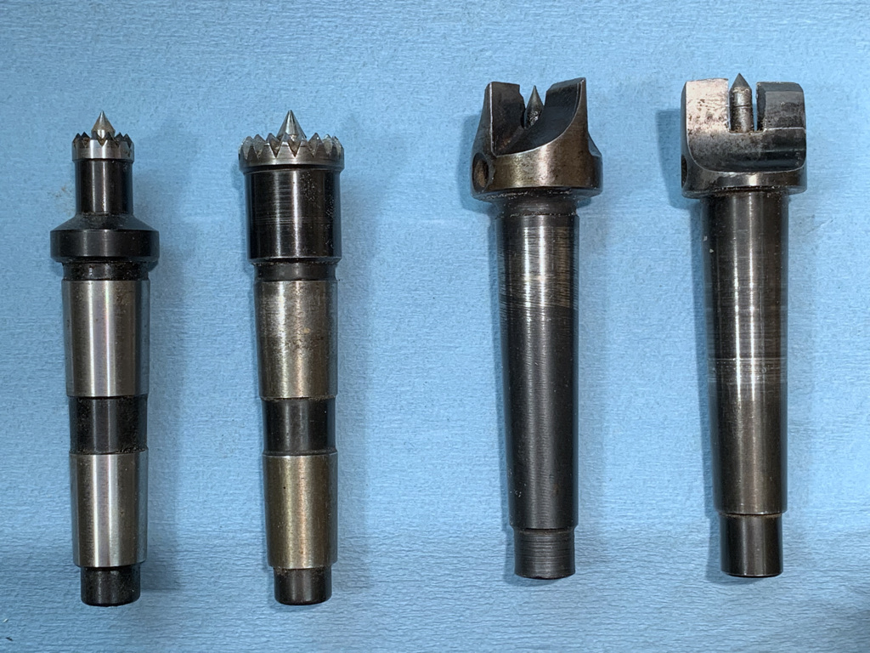
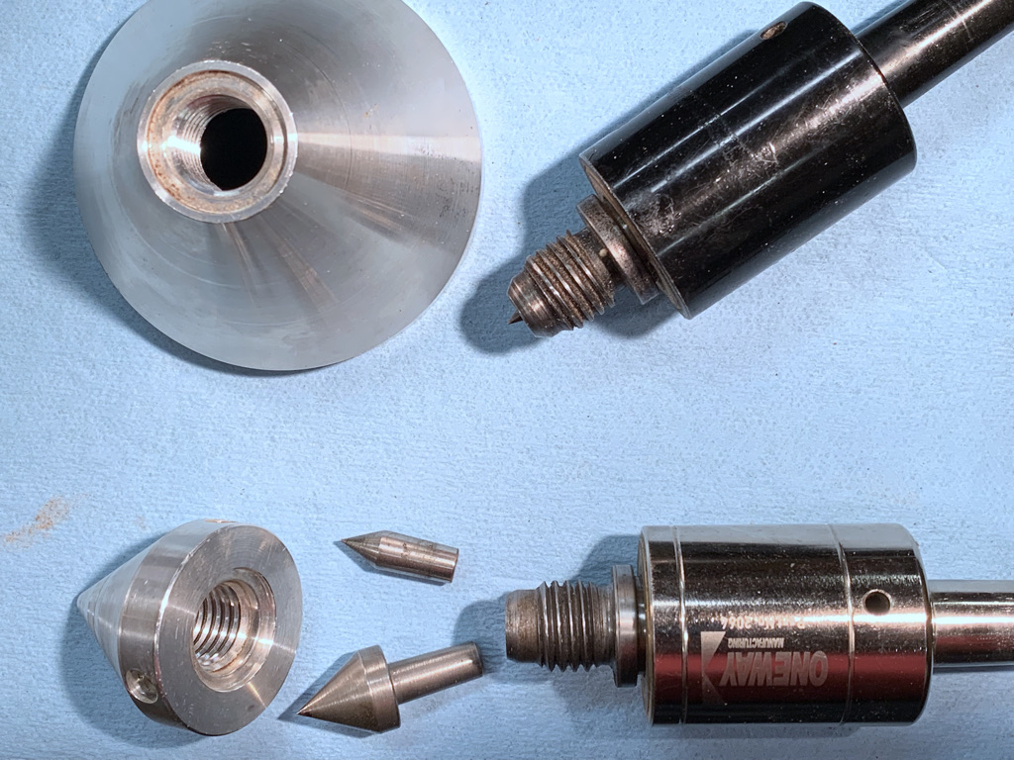
Morse Taper Accessories
Three sizes of Morse Taper - #2 is most common size;
Drive centers, live centers, and dead centers (not shown) are tapered;
Can be turned out of wood for special fitments (example in slide 12).

Slide 5
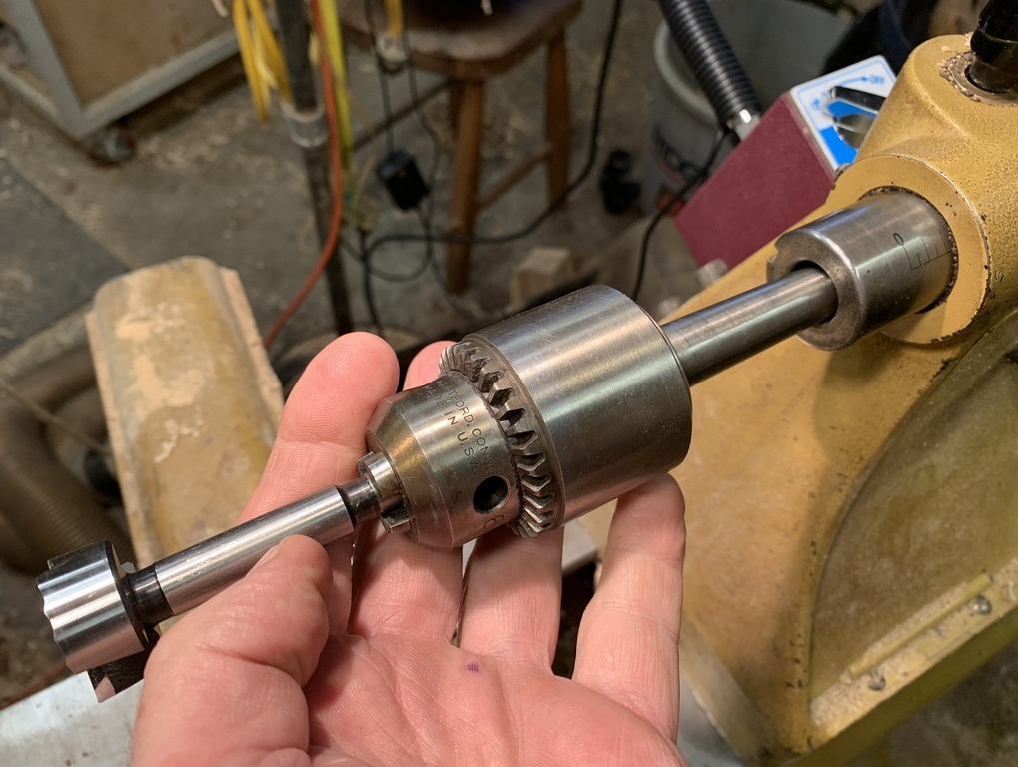
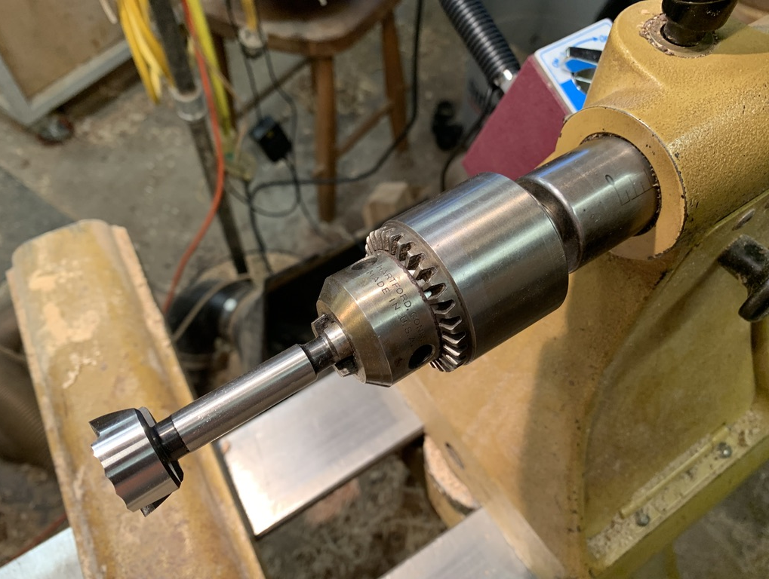
3-jaw Jacobs Chuck:
This accessory is the same as the one your floor model drill press has;
Has a #2 Morse Taper;
Allows use of the lathe as a horizontal boring machine;
Not appropriate for fixing wood to lathe for turning.

Slide 6
Accessories That Thread Onto A Drive Spindle
Face Plates
4-Jaw Scroll Chucks
Collet Chucks
Shop-Made Fitments
Metal Turning Chucks (No! No!)

Slide 7
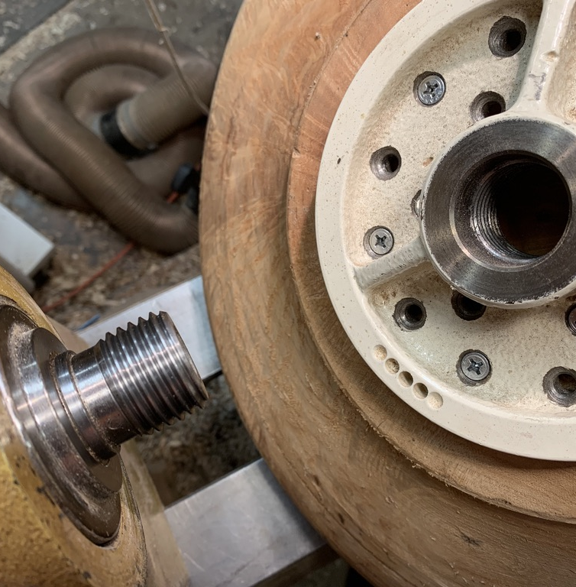
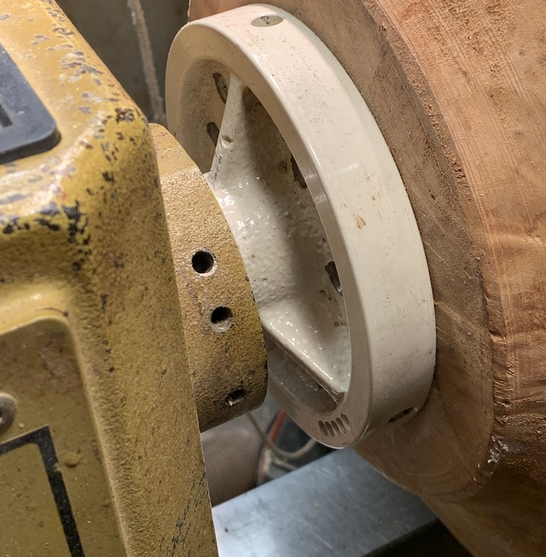
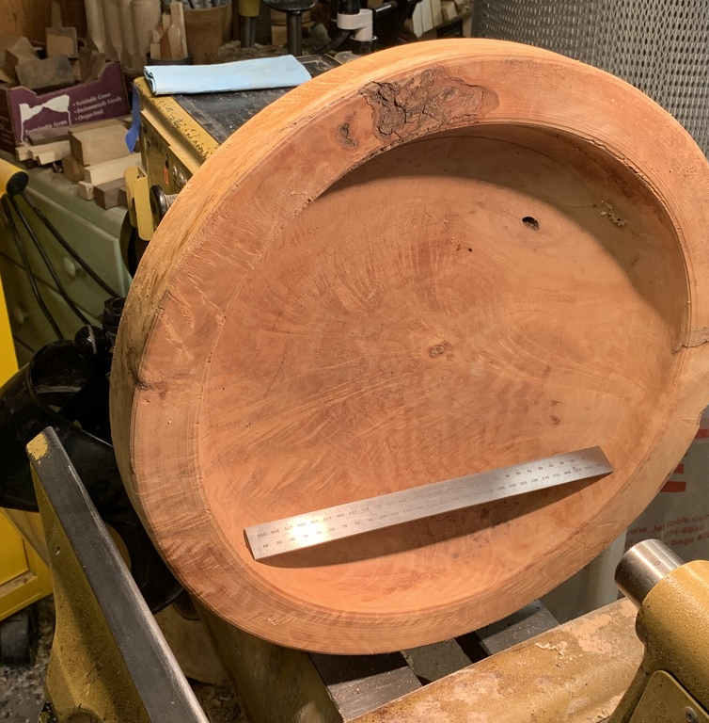
Steel Face Plate – very secure if fastened properly
Threaded to fit drive spindle;
Mated to flat surface on work piece;
Multiple wood screws join faceplate to work piece;
Allows turner to access face of work piece.

Slide 8
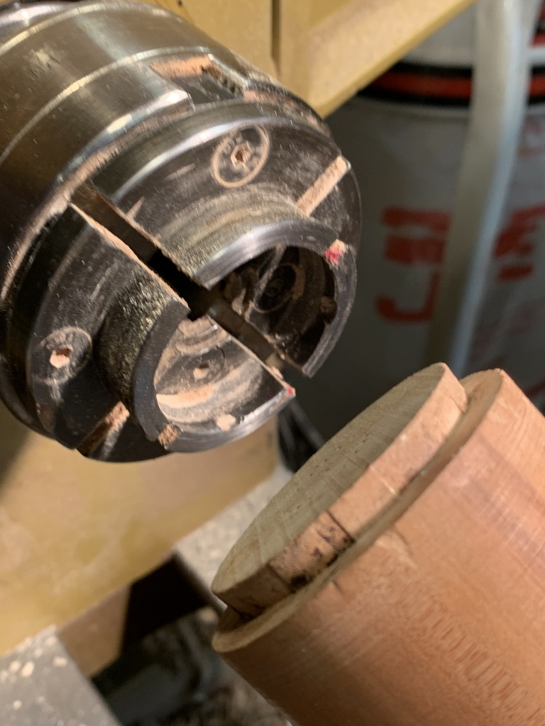
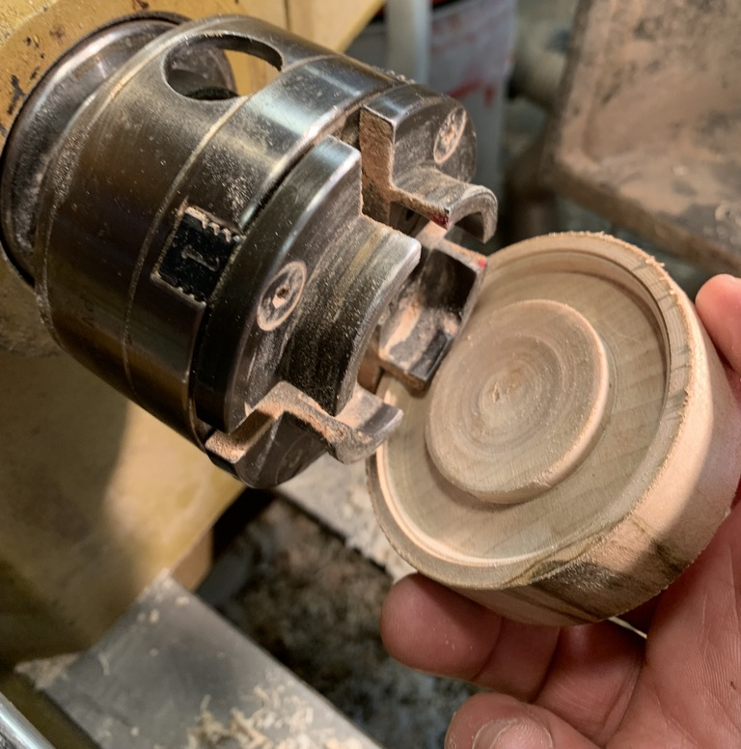
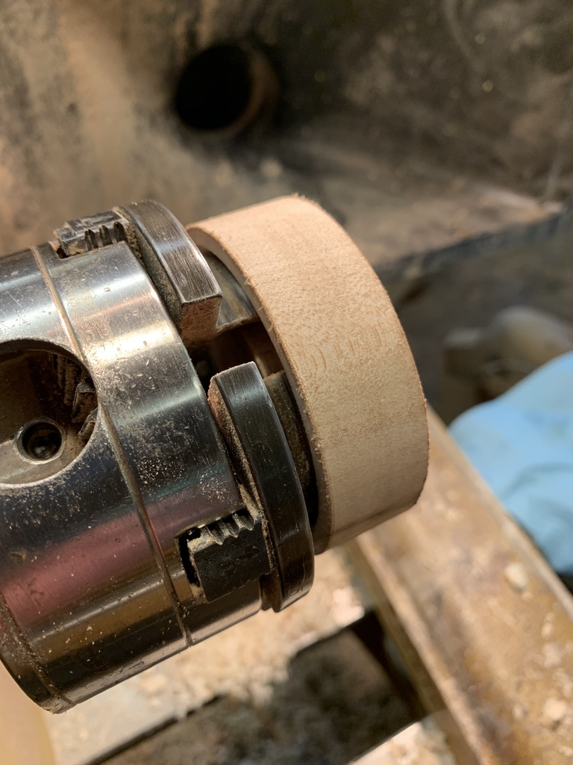
4-Jaw Scroll Chuck: Too versatile not to have.
4 jaws grip a spigot turned on the end of a work piece;
Can expand into recess cut into the bottom of a work piece;
Accepts different types of jaws for different applications.

Slide 9
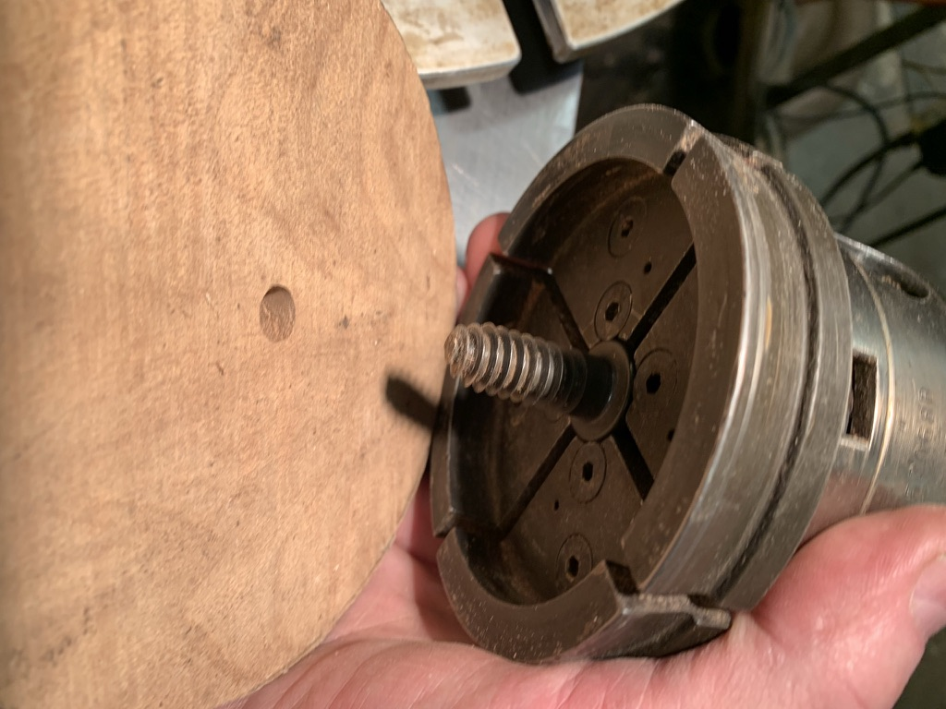
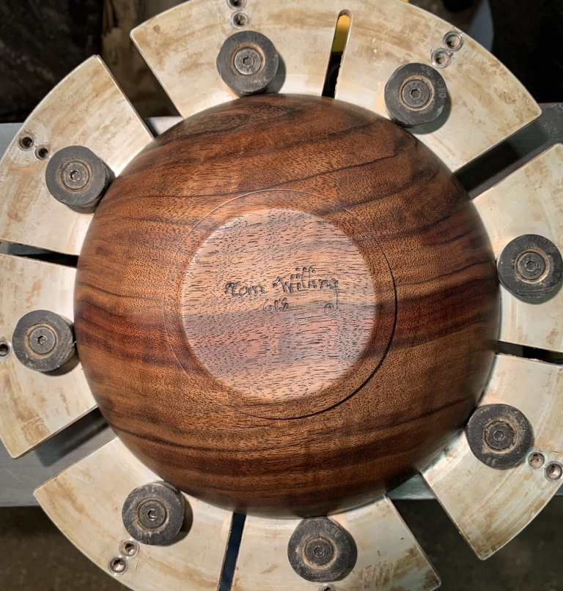
Screw Chuck
Single, centered screw goes into hole in bottom of workpiece and draws chuck and work piece together.
Not for large work pieces.
Cole Jaws/Longworth Chuck
Designed for large diameter work pieces; especially useful for finishing the bottoms of bowls, picture frames.
Keep RPM’s low!

Slide 10
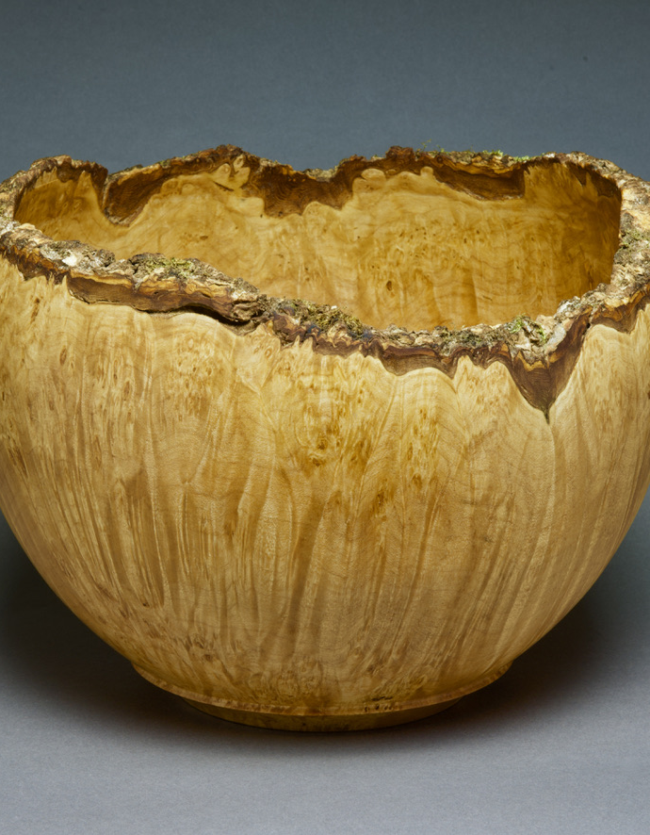
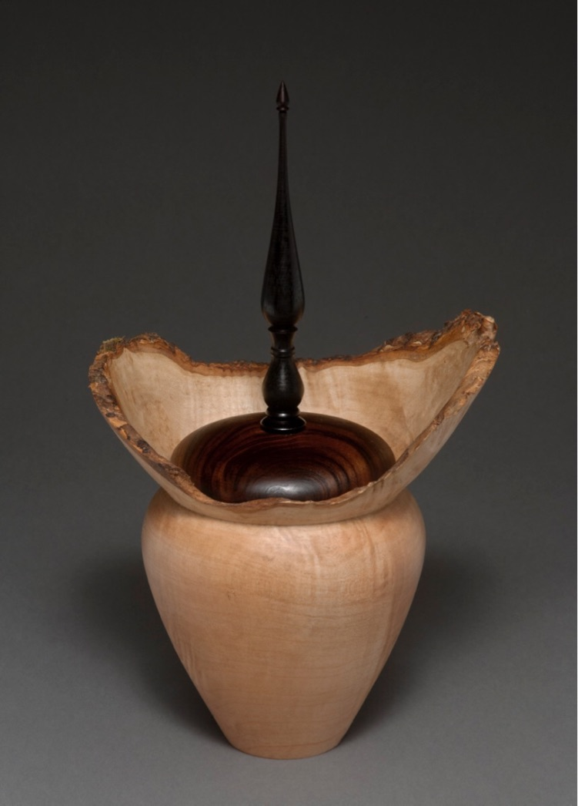
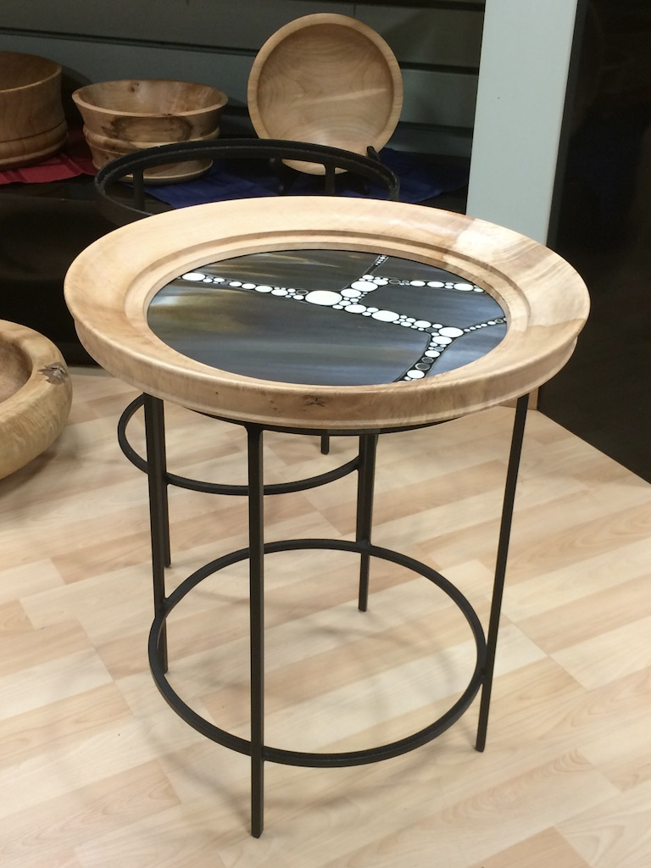
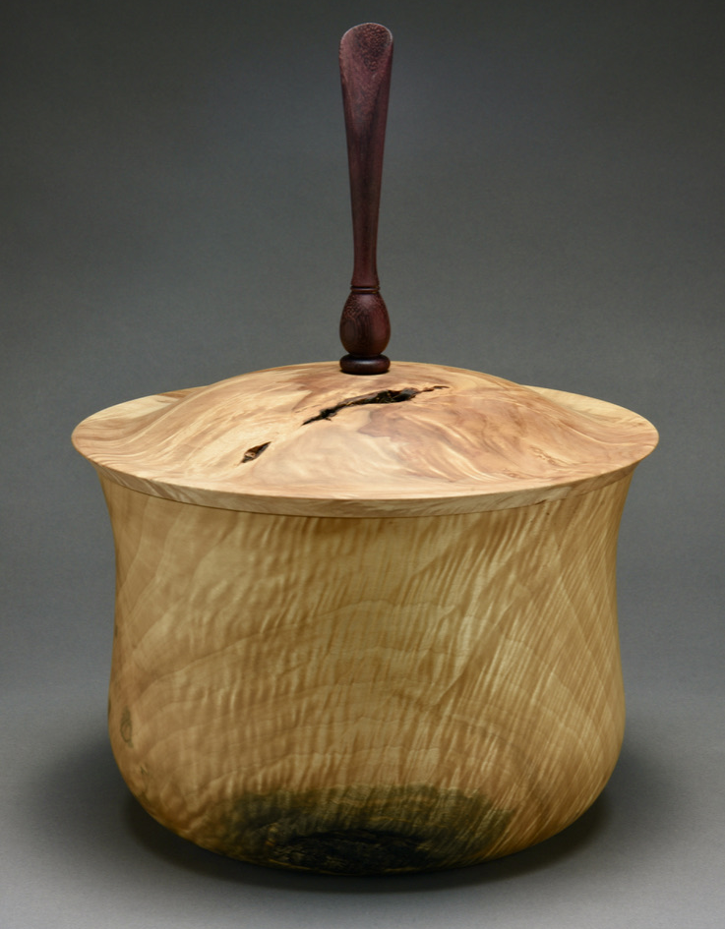
4-jaw Chucks are used for a wide range of turnings from small finials and trinket boxes, to hollow forms and bowls, to furniture components, to architectural forms such as balusters and newels.

Slide 11
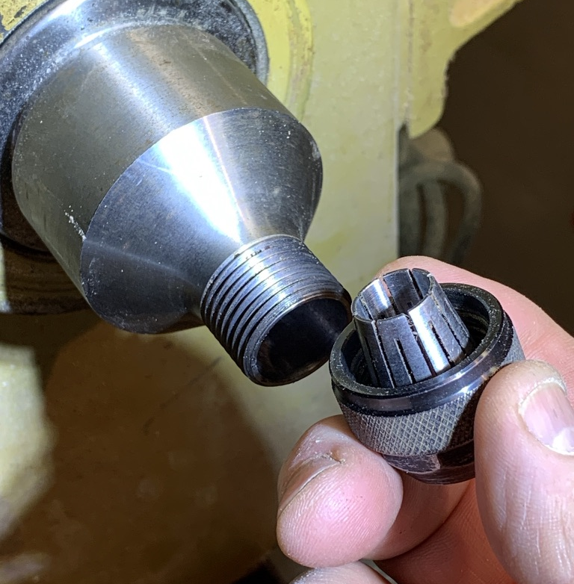
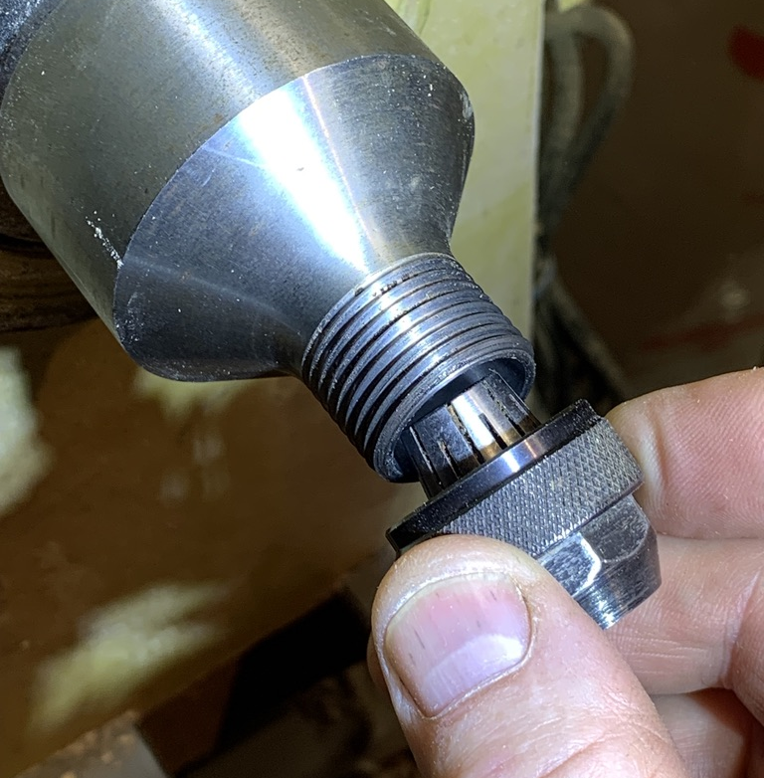
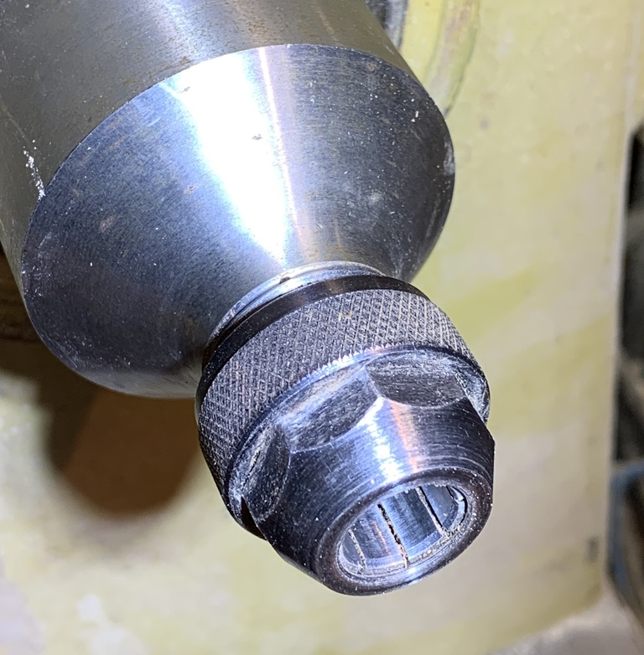
Collet Chuck:
Same as on a router;
Used for small, detailed work;
The collet body is machined to fit the drive spindle of your lathe;
Collets range in size from ½” down to ¼” diameters.

Slide 12
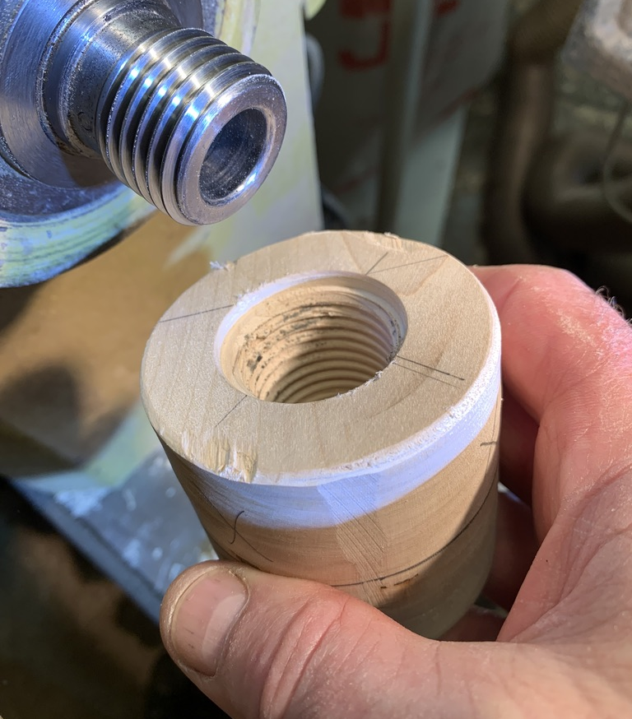
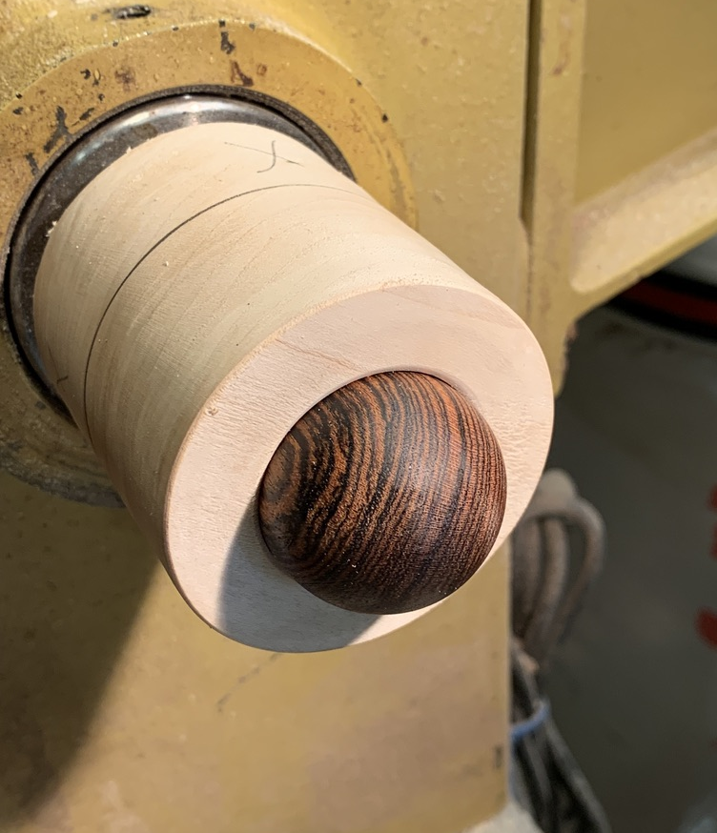
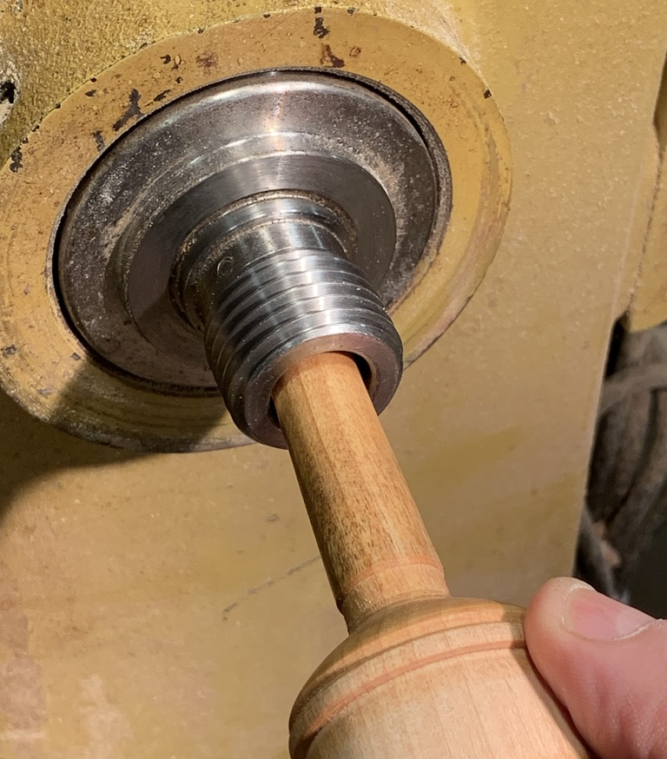
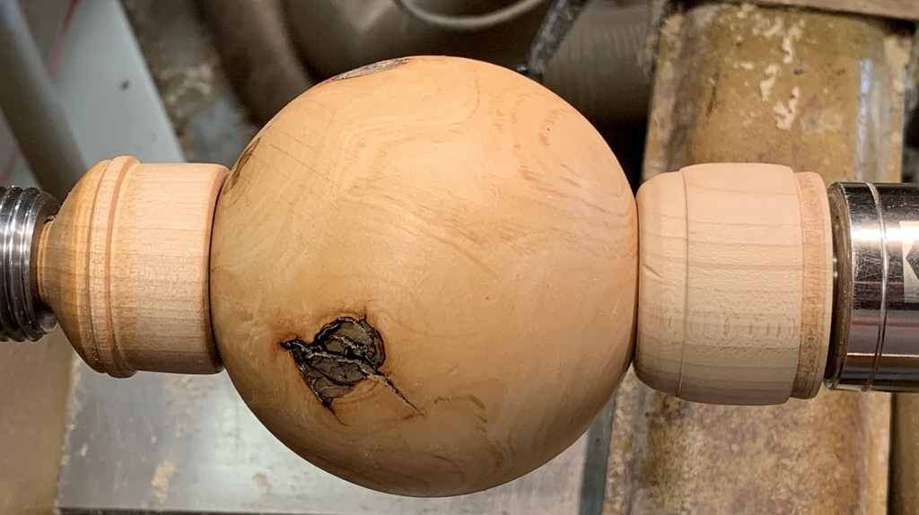
Shop-built Approaches Include:
Cup Chuck – fits around work piece.
Can be tapped and threaded onto the drive spindle, or
Fitted to, then gripped by a scroll chuck;
Spigot Chucks – male part fits into work piece;
Spindles that fit the taper of the drive spindle.

Slide 13
Conclusion and Transition: Why Turn?
Expands your range of design solutions;
Demands and Rewards Discipline;
50/50 balance between cost of a high-quality lathe and cost of high- quality accessories and cutting tools;
BEFORE you start making decisions you may regret, talk to a turner or two about what you want to do;
Get the absolute best machine and accessories you can afford;
Invest in training for yourself and your employees.

