Slide 1
WHY TURN
Everything you need to know to get started in Woodturning

Slide 2
Agenda
Why Turn – What can I make on a lathe
Picking a Lathe – Benchtop to free standing, power, what the numbers mean, etc
Chucking Techniques – How to hold the piece
Tools – gouges, scrappers, skews, etc – What each tool is for and what to start with
Sharpening equipment and jigs – Sharp tools are a MUST
Finishing a product – A perfect bowl with a crappy finish is a crappy bowl
Resources – Local and online

Slide 3
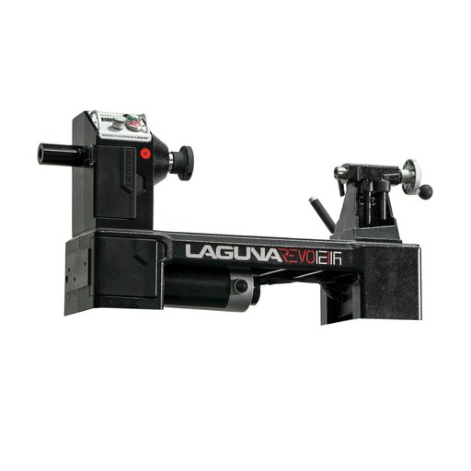
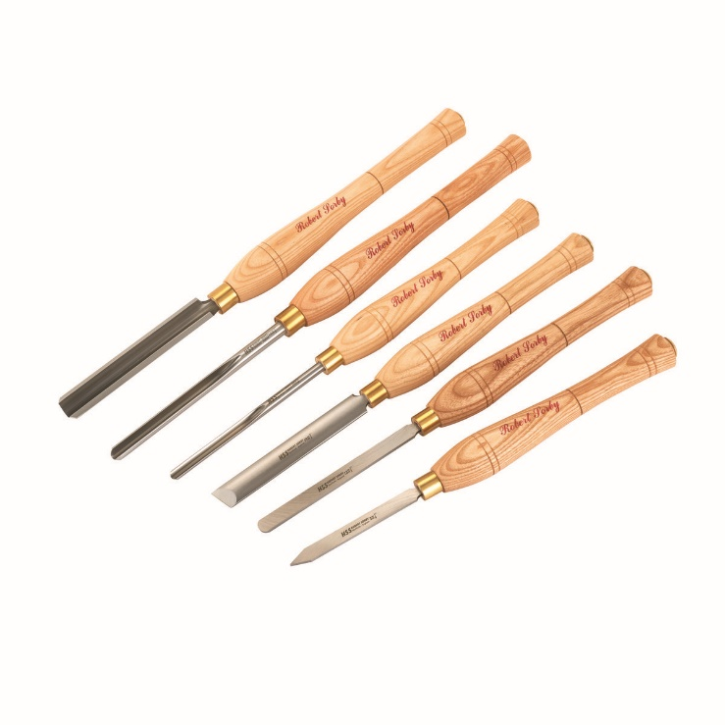
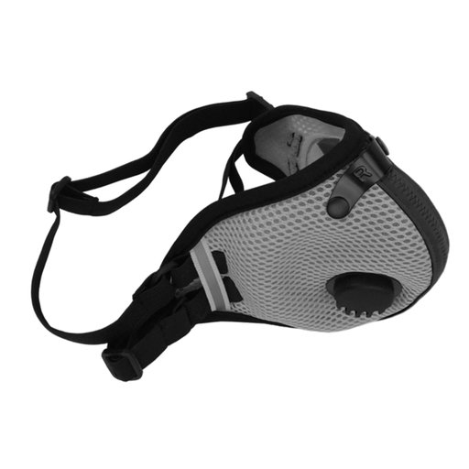
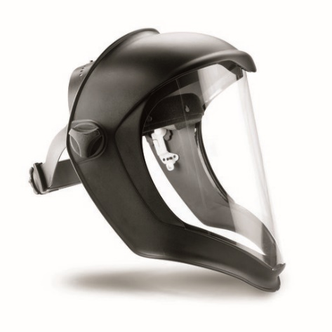
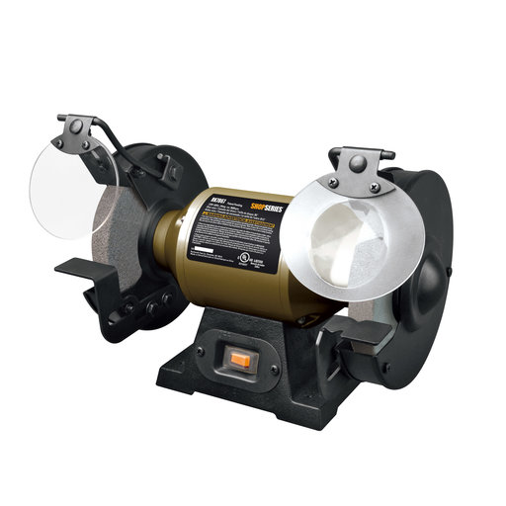
Basics We Will Cover
Lathe – comes with tool rest, face plate and tailstock live center and headstock
Need good lighting
Slow Speed Grinder & Sharpening Jigs
Basic set of Tools
PPE – Face Shield, Dust mask, hearing protection

Slide 4
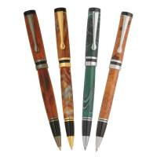
Pens
Often the first turning project
Huge number of offerings – https://www.pennstateind.com/
Minimal tools & Equipment needed
Instant gratification – make a pen in less than an hour
Fantastic gifts
Tools – parting tool, scrapper/skew/gouge, pen jig, sandpaper, finish
Firefighters
Specialty Pens

Slide 5
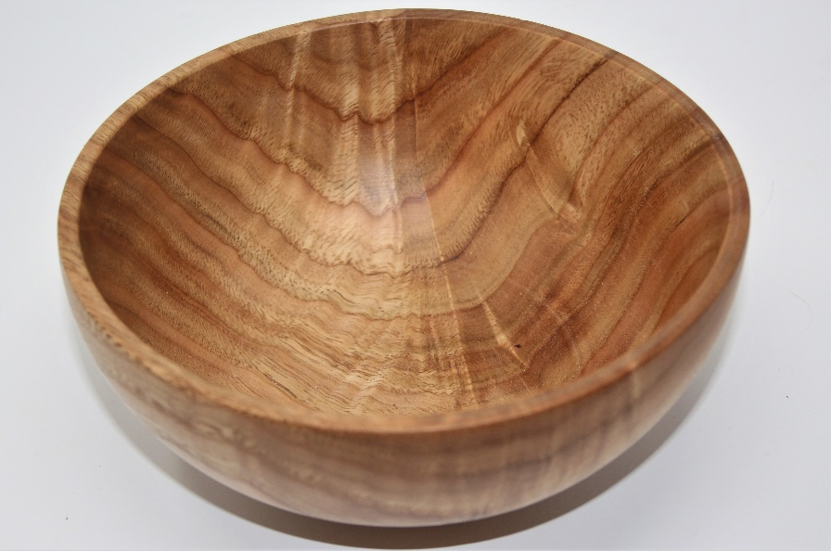
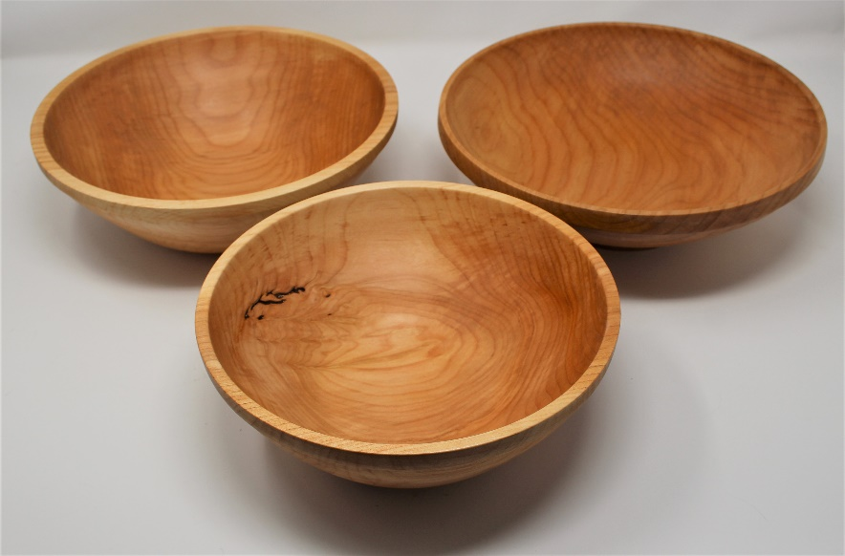
Bowls
Probably the next project for most.
Bowls are popular gifts and sell well
Twice Turned Bowls – rough out the bowl, let it dry for months, finish turn them for perfectly round bowls
Once Turned Bowls – turn the bowl all the way (thinner the better) and let nature do its thing
Tools – Bowl Gouge & Scrapper

Slide 6
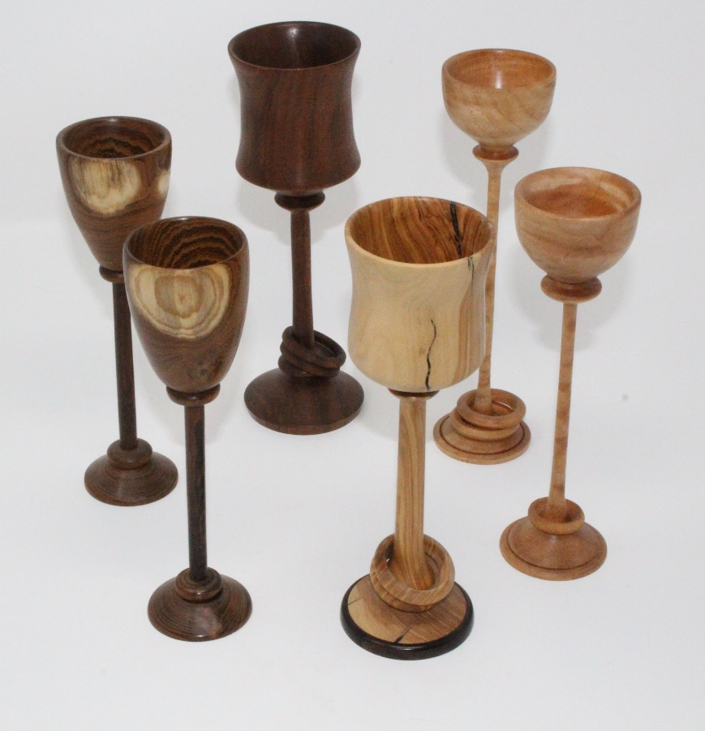
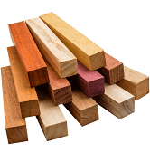
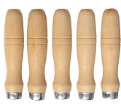
Spindle Work
Examples are legs, tool handles, goblets, finials
Turn Between Centers
Cutting all side grain
Tools – Spindle Roughing Gouge, Spindle Gouge, Skew

Slide 7
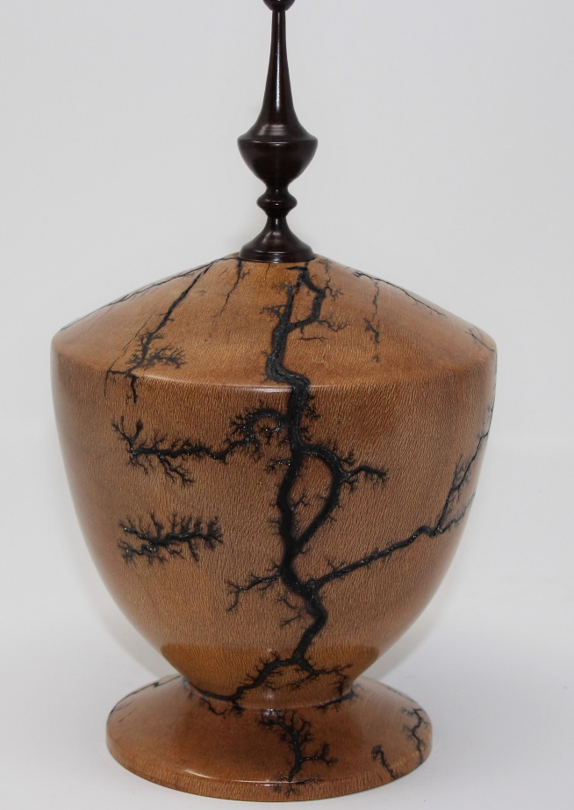
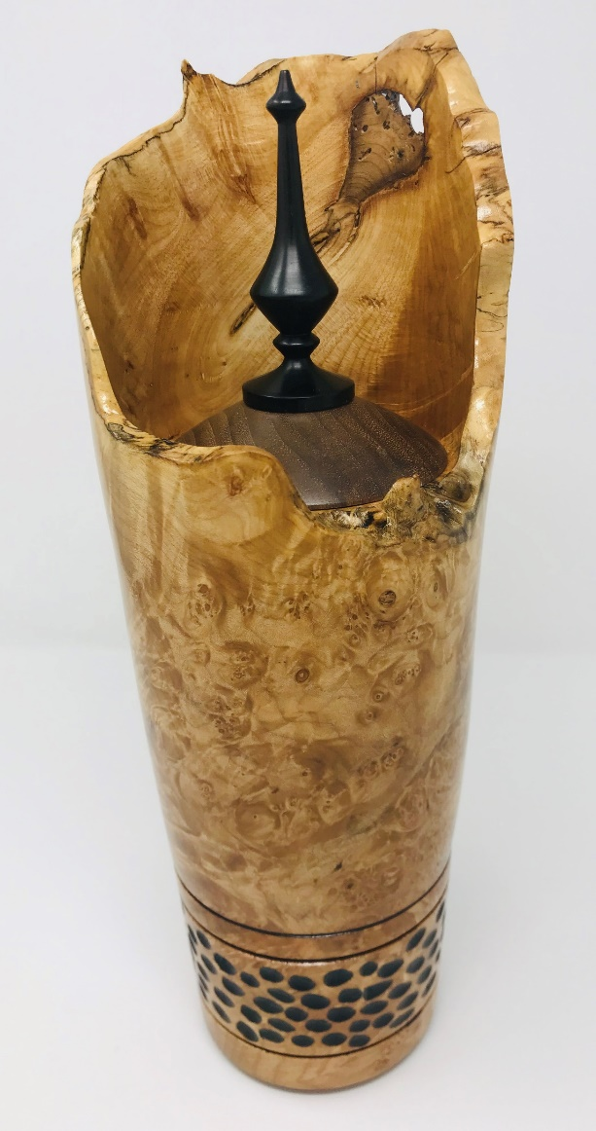
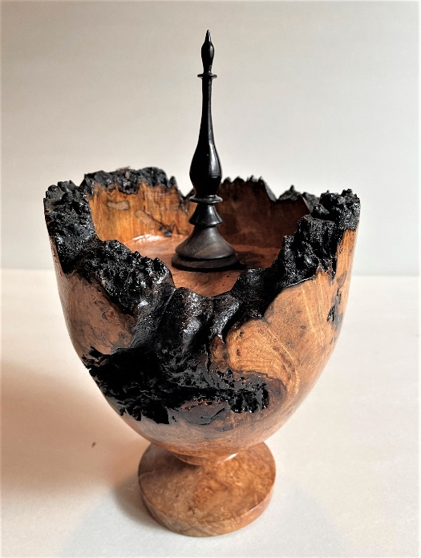
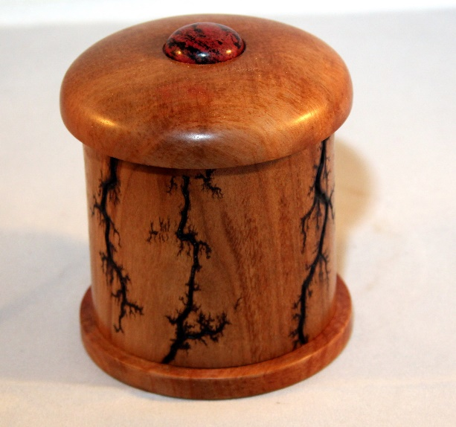
Hollow Forms
Vases, urns, some type of boxes
Advanced skills needed
Jigs required for larger items
Special tools used – hollowing tools

Slide 8
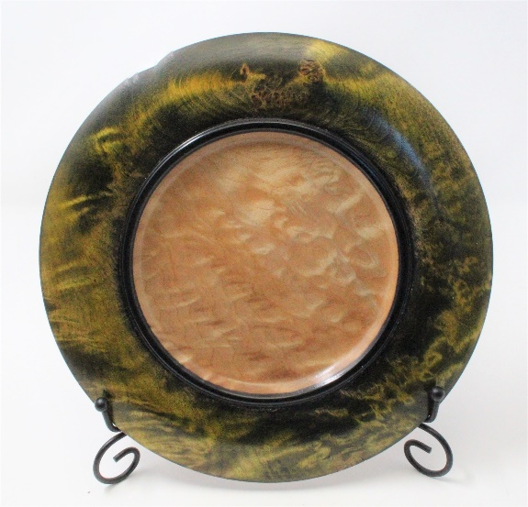
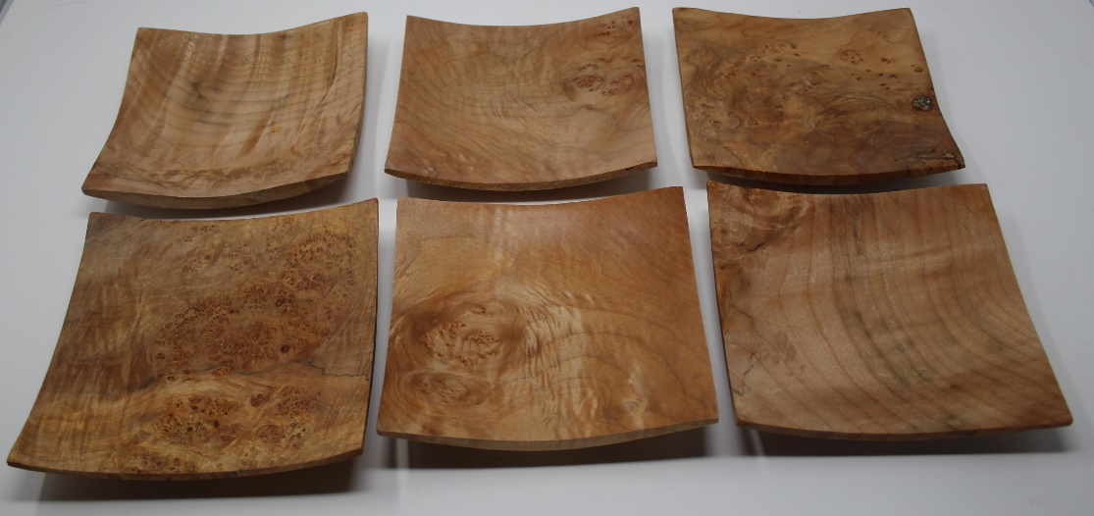
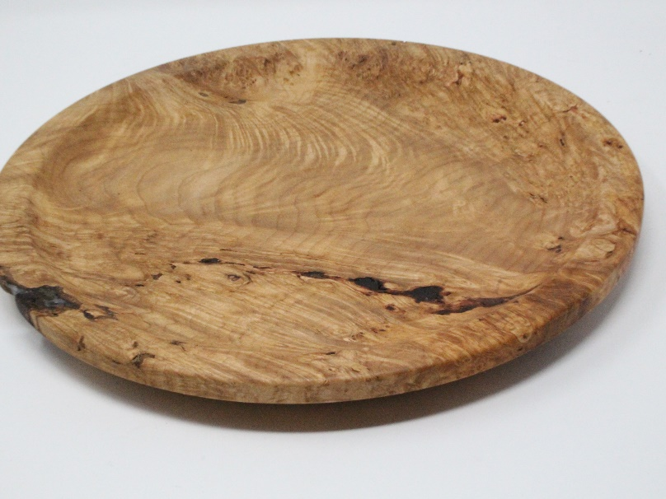
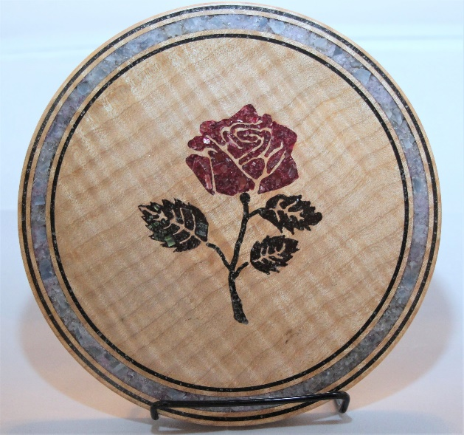
Plates & Platters
Functional or Decorative
Round or square
Tools – Bowl Gouge & Scrappers

Slide 9
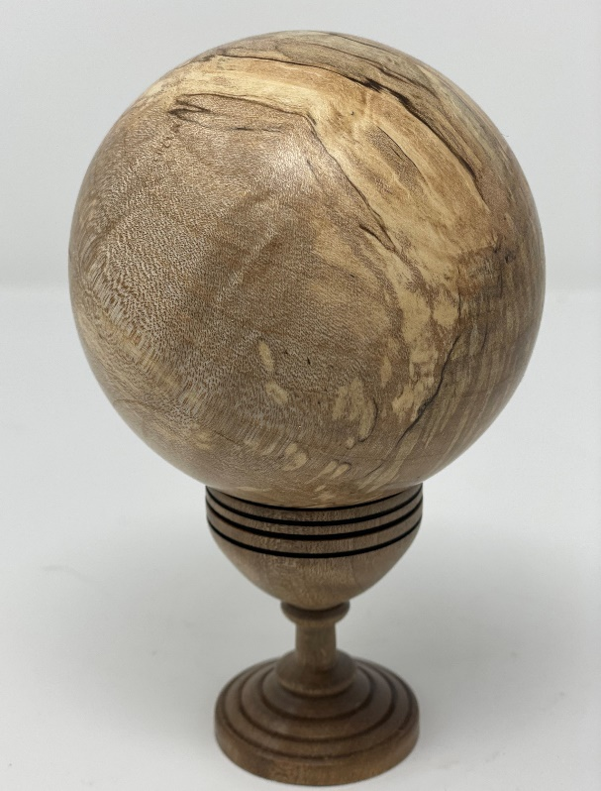
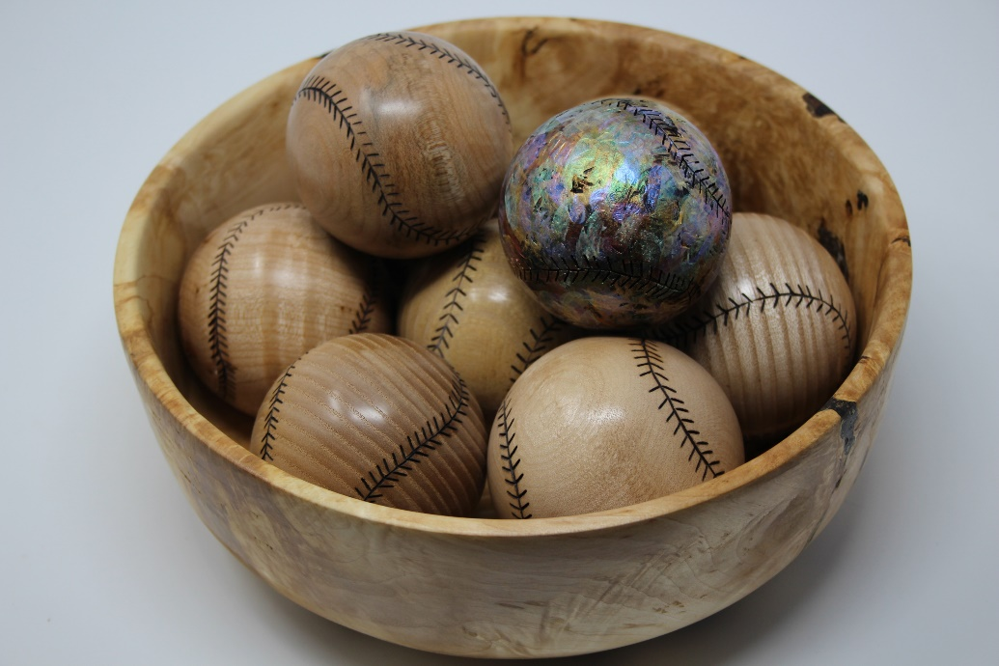
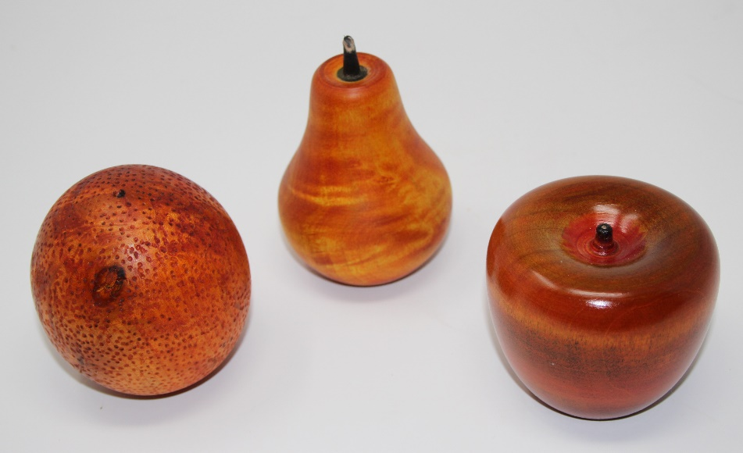
Spheres & Eggs
Advanced techniques
Chucking challenges
“How do you make a 3” sphere – start with a 4” sphere”

Slide 10
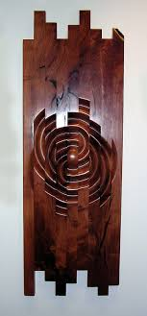
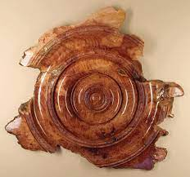
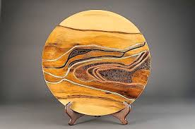
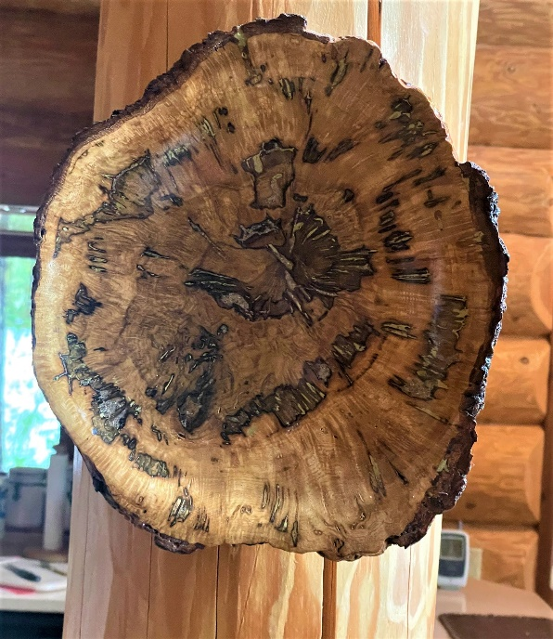
Wall Art
Lots of opportunity to be creative, use “Junk Wood”, offset turning, carving, painting
Let your imagination run wild

Slide 11
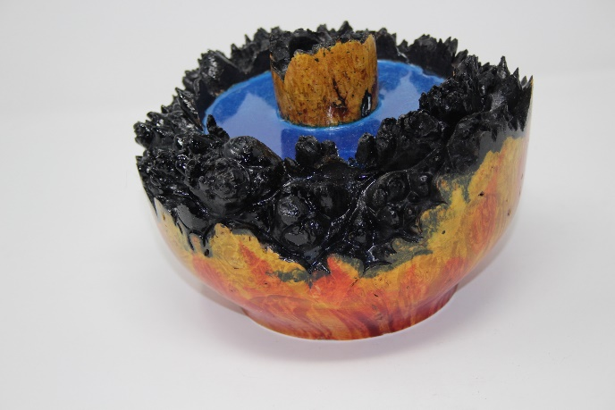
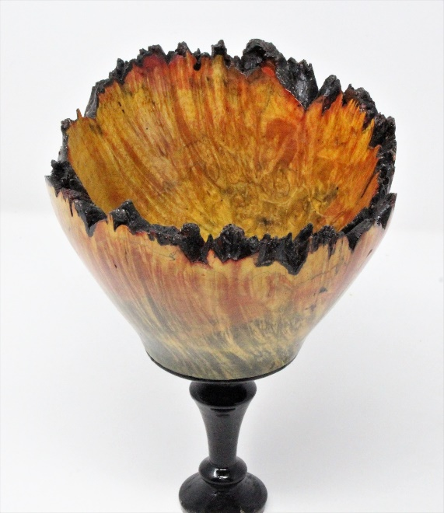
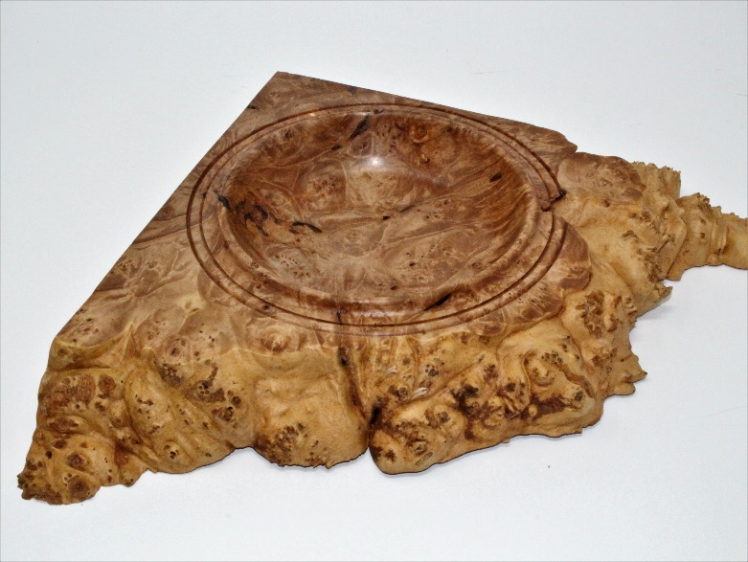
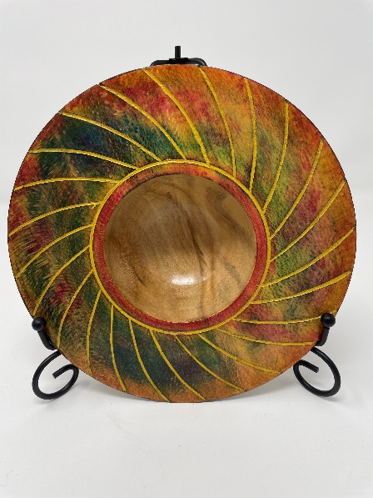
Functional vs. Artistic
Most bowls and platters can be functional pieces which is most satisfying
Items with embellishments can look spectacular but often not used

Slide 12
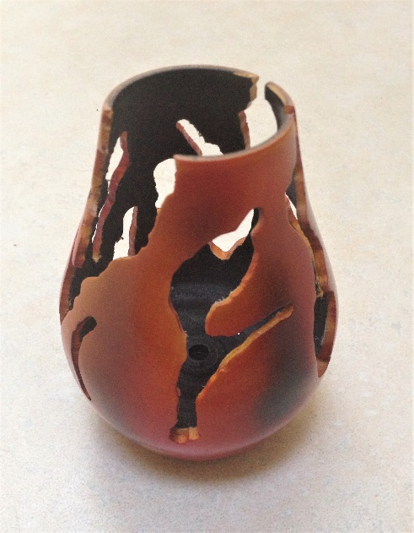
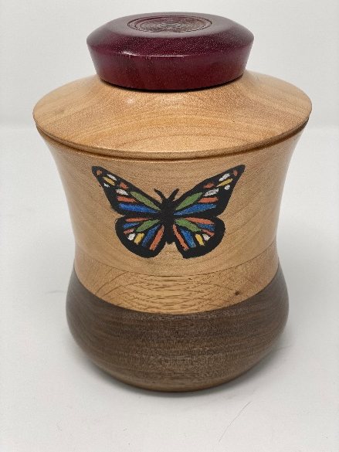
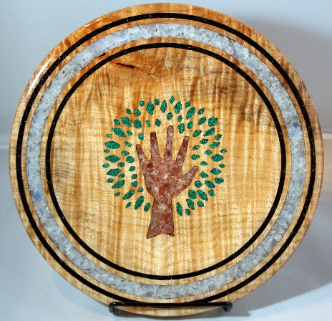
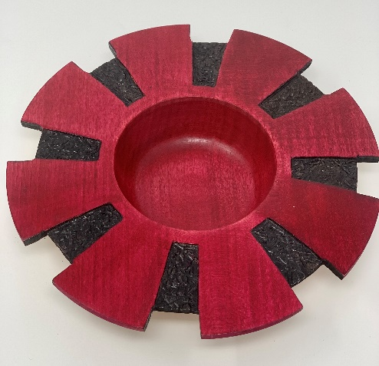
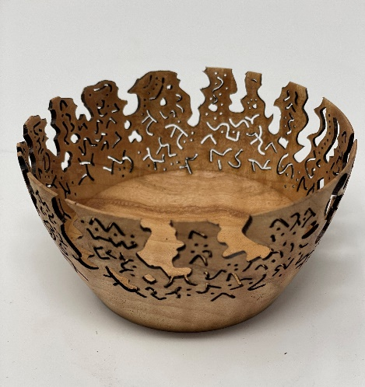
Embellishments
Many techniques to make your products standout
Pyrography
Painting
Carving
Inlays
Burning
Fuming

Slide 13
Why Turn
It is fun
It is addictive
It is relaxing
But
It can be dangerous
It requires training
It is not cheap but getting started can be affordable

Slide 14
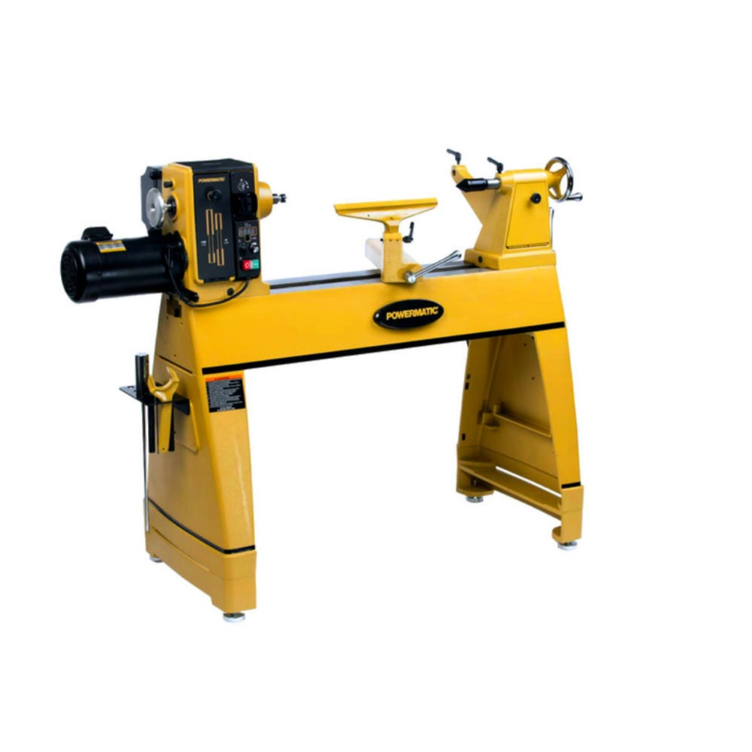
Next – THE LATHE

